Slide 1
Group 7 Project: Turtlebot robot following each other
By: Reamy Muong, Yu Yang, Douglas Bacon

Slide 2
Key Objectives
Generate and design a 3D office environment on Gazebo
Use RGB and depth camera to detect marker and guider position
Develop code to follow guider in the environment
Implement collision detection using available sensors
Create a demo video showing our final results and achievements

Slide 3
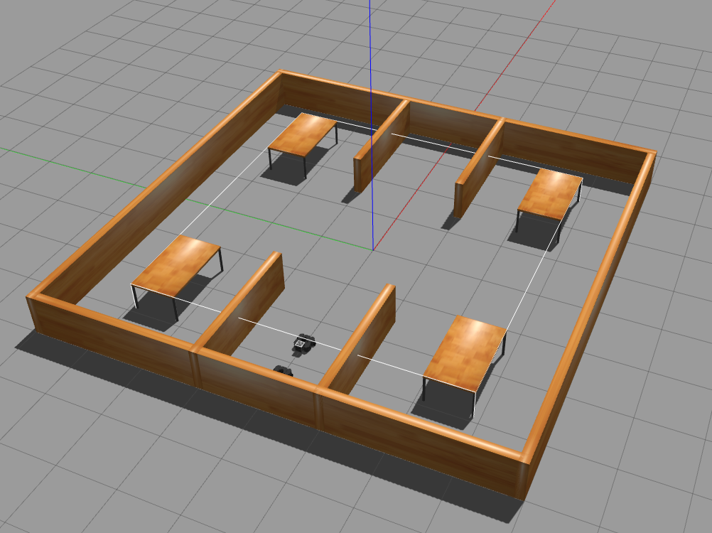
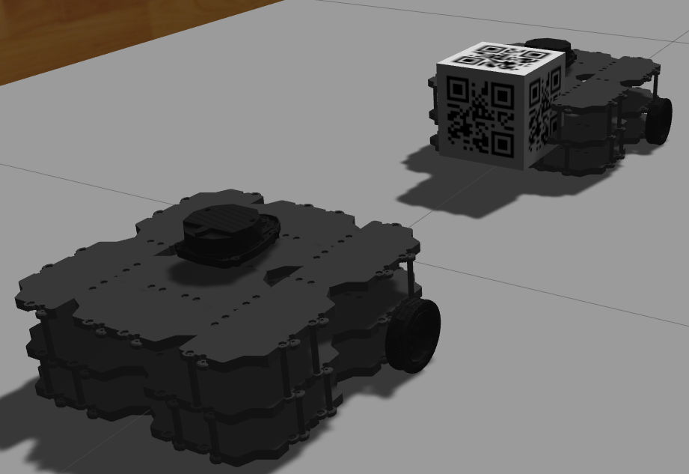
Environment Generation
Find best way to launch 2 separate robots
Create a simple world to test the project
Ensure the correct spacing between robots
Dependency on turtlebot_3 gazebo for build files

Slide 4
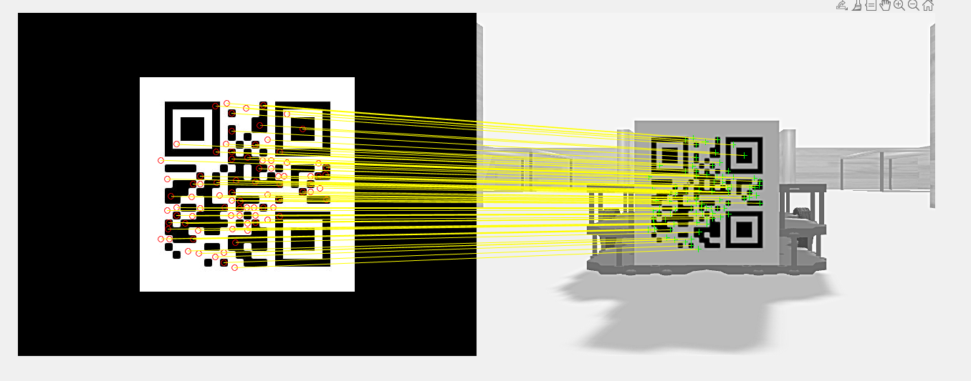
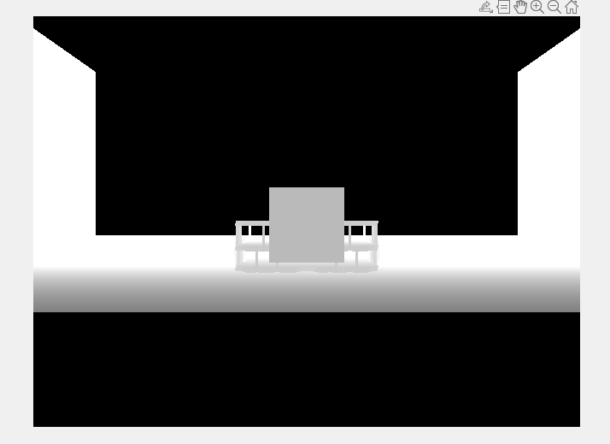
Image Processing (Feature Detection)
Turtlebot Waffle Pi ( RGB and depth camera)
Marker (QR code) is position behind the guider.
Process:
Detect SURF Features
Extract Features
Match Features
Get the inlier points
Retrieve depth at the points

Slide 5
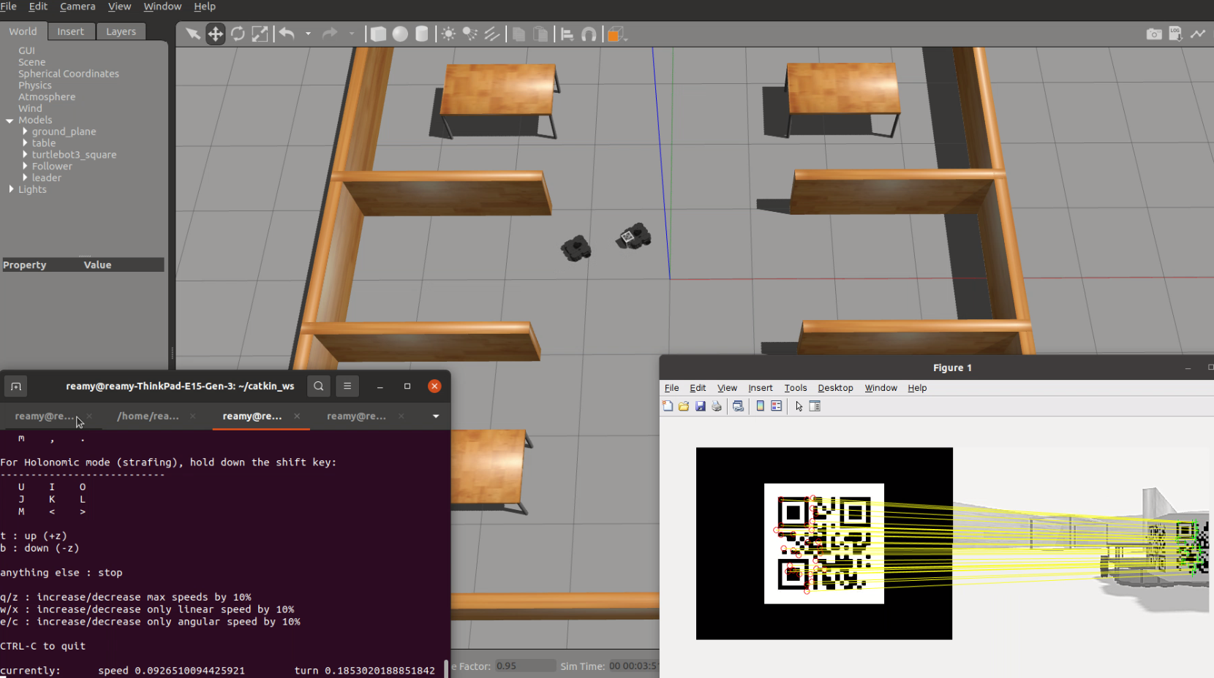
Turtlebot Following Strategy
Feature extraction and depth values
Calculate the centroid of the matched features and corresponding depth values
Triangulation
Rotate towards the QR
Generate a point a certain distance behind the Guider
Move to intersection point
Check if it has reached point

Slide 6
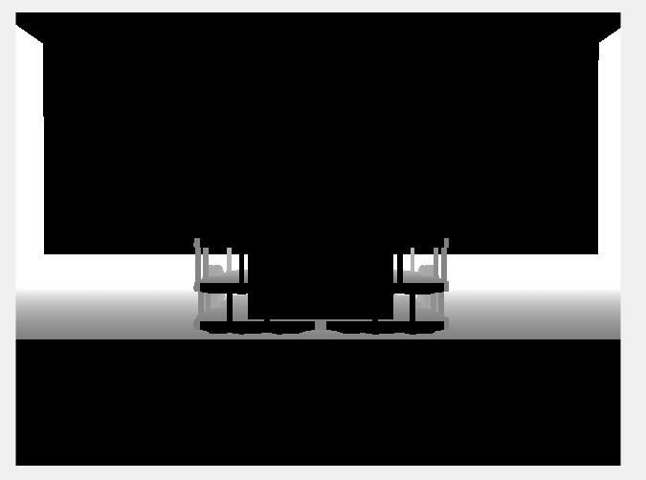
Problems Encountered and Results
Finding optimal distance between the robots
Visual issues with RGB-D camera
Stopping the follower before it hit the leader
Turning issues at large angles.

Slide 7
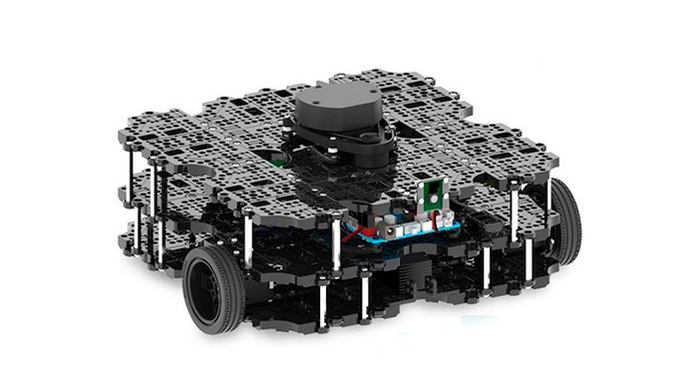
Future Works
Implementing a PID controller
Trialing with proper hardware
Develop a more robust search function

Slide 8
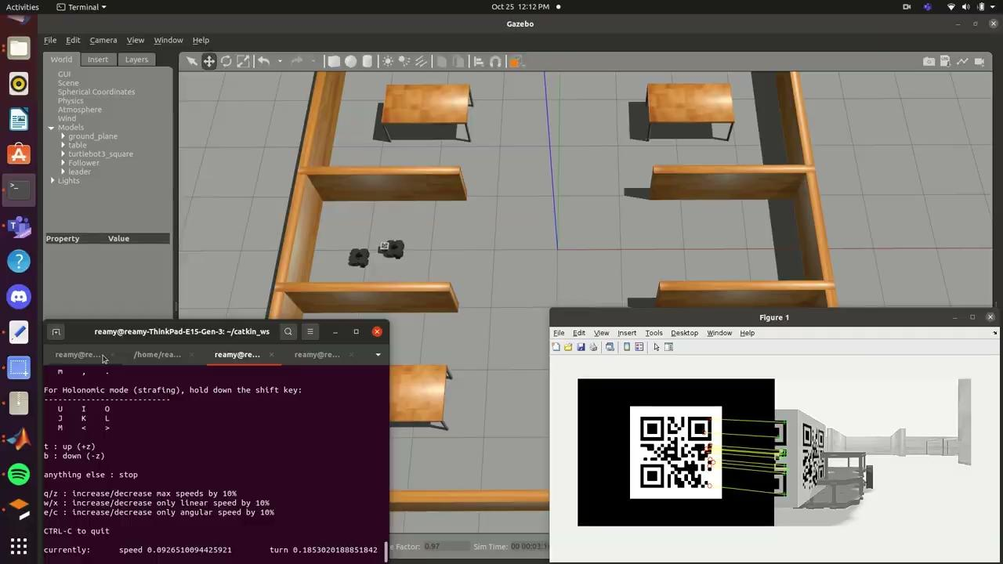
Video

Slide 9
Thank You!

